Slide 1
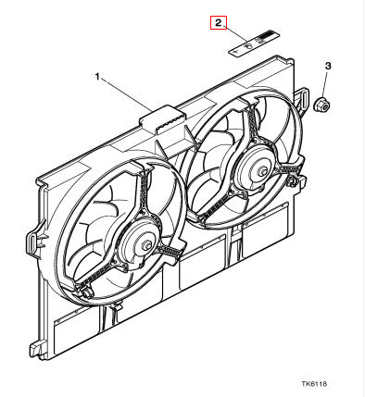
Parts tree
[show only relevant path(s)]
Search: MJB7703AA
[when empty update Model Ranges and part tree
suitability list to show all models and
main levels which parts stock has]
Availability:
[Selection List of Stock available part qualities
A…E with descriptions]
Suitability Model Ranges
[Filter & Check Boxes show fit]
ACCESSORIES/CONSUMABLES/INDEX
AIR AND FUEL DELIVERY SYSTEMS
AIR CONDITIONING/HEATING/VENTILATION
BATTERY/STARTER MOTOR/ALTERNATOR
BODY CLOSURES AND SEALING
BODY METAL PANELS AND SEALING
BRAKING SYSTEM
ELECTRICAL DISTRIBUTION SYSTEM
ENGINE
ENGINE COOLING SYSTEM
EXPANSION TANK
RADIATOR AND HOSES
RADIATOR FAN AND FAN MOTORS
COOLING FAN AND COWL-4.0 LITRE-V8
WATER PUMP
WATER RAIL AND THERMOSTAT
ENGINE MANAGEMENT/EMISSION SYSTEMS
EXHAUST SYSTEM AND COMPONENTS
EXTERIOR FITTINGS AND SUNROOF
IN CAR ENTERTAINMENT
INFORMATION SYSTEMS AND CONTROLS
INTERIOR TRIM AND LININGS
LIGHTING - EXTERIOR/INTERIOR
LOCKING/SECURITY SYSTEMS/HORNS
OCCUPANT RESTRAINTS
SEATING
STEERING AND SUSPENSION
TRANSMISSION AND DRIVELINE
WIPER AND WASHER SYSTEMS
Jaguar Accessories
Daimler Limousine
E-Pace
E-Type
F-Pace
F-Type
S-Type
X-Type
XE Range
XF Range
XJ Range
XJS Coupe/Convertible
[x] XK Range (Modern)
Location at car:
Suitability/Filter (or fact when one part number is selected):
[Selection list(s)] [<Models><ModelYear><VINRanges> <features> <etc>]
Applicability matches / filter list(s)
XK From VIN (A08929)
Coupe
Convertible
4.0 Litre
supercharged
Other Option
(i) Icon is link to open
[Model Family & Year Introduction
PDF Document]
.Fan warning label [MJB7703AA] Item 1
Classic Part - Superceded
[Part name and Part exploding image]

Slide 2
Parts tree
[show only relevant path(s)]
Search part #: MJB7703AA
[when empty update Model Ranges and suitability tree to
show all models and main levels which parts stock has]
Suitaility Model Ranges
[Filter & Check Boxes show fit]
ACCESSORIES/CONSUMABLES/INDEX
AIR AND FUEL DELIVERY SYSTEMS
AIR CONDITIONING/HEATING/VENTILATION
BATTERY/STARTER MOTOR/ALTERNATOR
BODY CLOSURES AND SEALING
BODY METAL PANELS AND SEALING
BRAKING SYSTEM
ELECTRICAL DISTRIBUTION SYSTEM
ENGINE
ENGINE COOLING SYSTEM
EXPANSION TANK
RADIATOR AND HOSES
RADIATOR FAN AND FAN MOTORS
COOLING FAN AND COWL-4.0 LITRE-V8
WATER PUMP
WATER RAIL AND THERMOSTAT
ENGINE MANAGEMENT/EMISSION SYSTEMS
EXHAUST SYSTEM AND COMPONENTS
EXTERIOR FITTINGS AND SUNROOF
IN CAR ENTERTAINMENT
INFORMATION SYSTEMS AND CONTROLS
INTERIOR TRIM AND LININGS
LIGHTING - EXTERIOR/INTERIOR
LOCKING/SECURITY SYSTEMS/HORNS
OCCUPANT RESTRAINTS
SEATING
STEERING AND SUSPENSION
TRANSMISSION AND DRIVELINE
WIPER AND WASHER SYSTEMS
Location at car:
Jaguar Accessories
Daimler Limousine
E-Pace
E-Type
F-Pace
F-Type
S-Type
X-Type
XE Range
XF Range
XJ Range
XJS Coupe/Convertible
[x] XK Range (Modern)
.Fan warning label
[Part name and Part exploding image]
Suitability:
[Scrolling list] [<Models><ModelYear><VINRanges> -> <specificatios>]
XK8 Coupe/Convertible From (V) A00083 To (V) A30644 → 4.0 Litre supercharged From VIN (A08929) Other Option

Slide 3
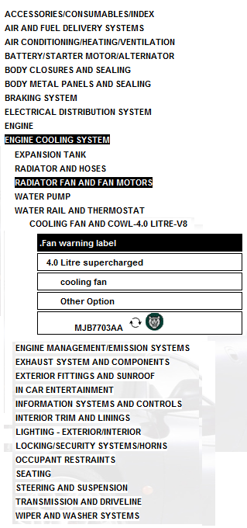
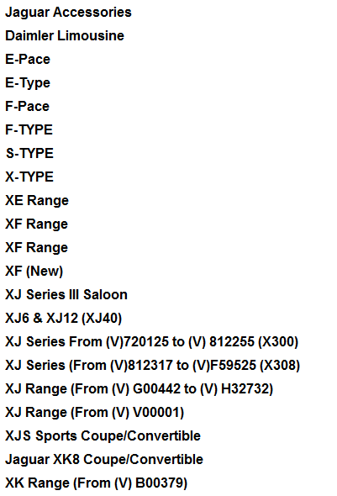
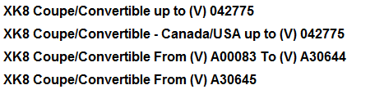
Search part #: MJB7703AA
X
X
X
X

Slide 4
Search part #: MJB7703AA
Parts tree
Part exploding image
Location at car:
Front, Middle
Fits to car models
X
X
X
X

Slide 5
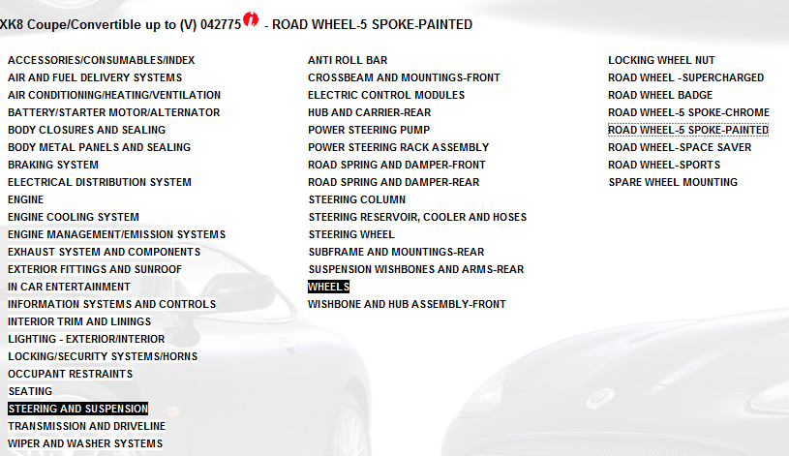
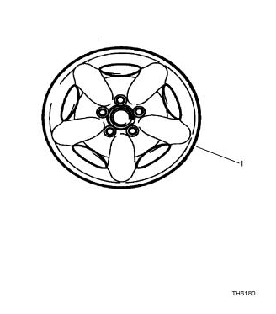
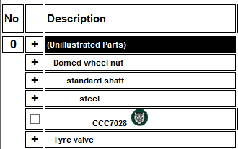
Search part #: MJB7703AA
Parts tree
Part exploding image
Location at car:
Front, Rear, Left, Right
Fits to car models
X
X
X
X

